Slide 1
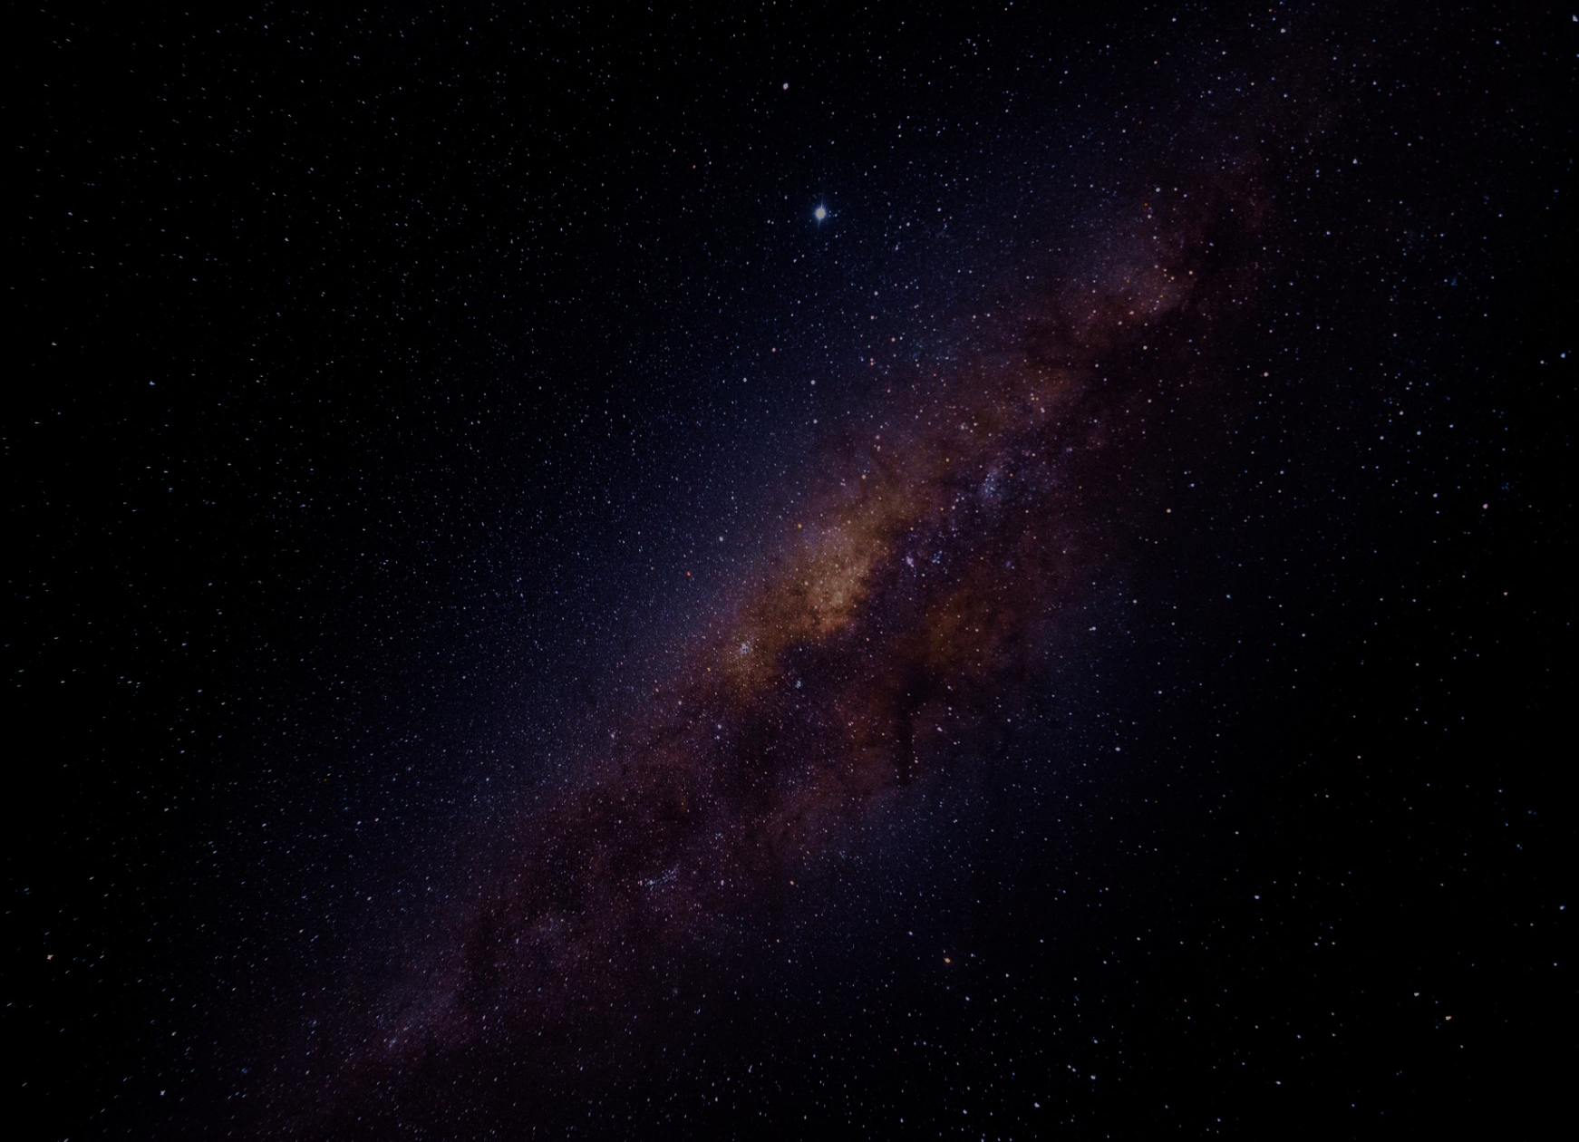


Predicting Exoplanet Habitability from NASA using Machine Learning and Data Analysis
Samia Mahmood
DS-450: Data Science Senior Capstone
January 11, 2026
1

Slide 2
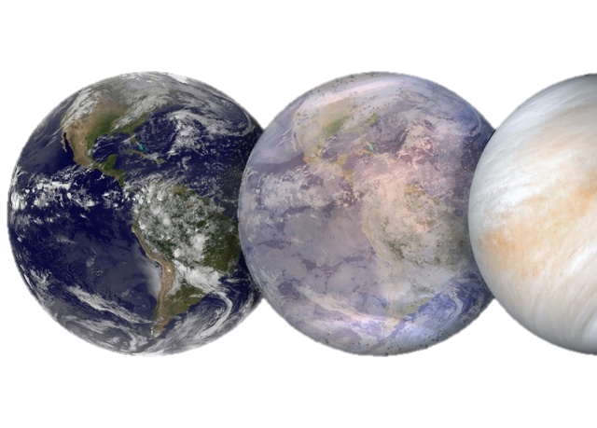
Project Overview (Problem & Proposed Solution)
Problem to Solve:
Currently know of one habitable planet, Earth → Could there be more?
Rapid growth of exoplanet discoveries → created challenges in studying exoplanets:
Outpaced our ability to efficiently characterize and assess habitability
Astronomical datasets are large-scale, high-dimensional, and incomplete, making manual analysis difficult
Proposed Solution:
Apply a structured reproducible data analytics and machine learning framework
Analyze exoplanet and stellar properties using NASA’s Exoplanet Archive
Use predictive modeling and classification to:
Explore relationships between stellar and planetary properties
Identify natural groupings of exoplanets
Predict exoplanet habitability potential
Determine top 5 Earth-analog candidates
2

Slide 3
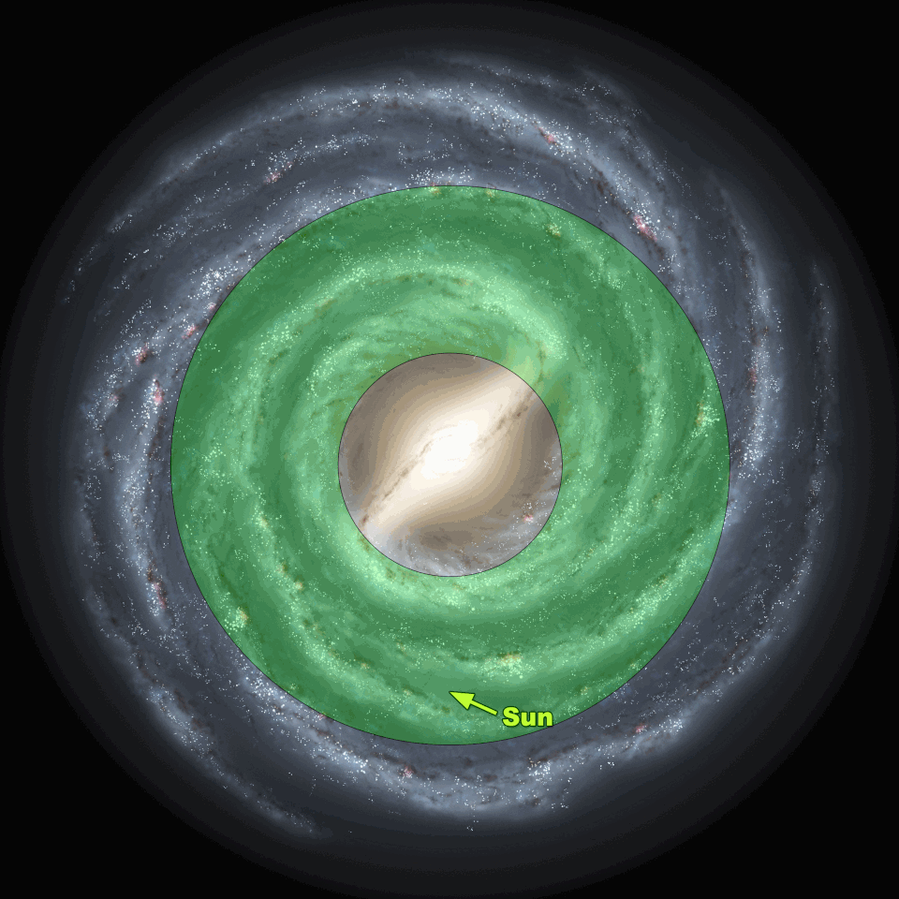
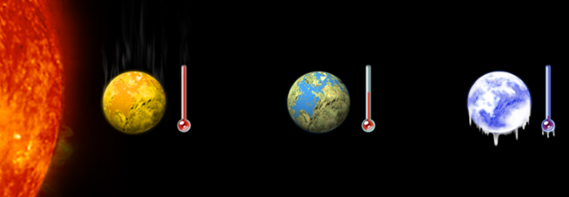
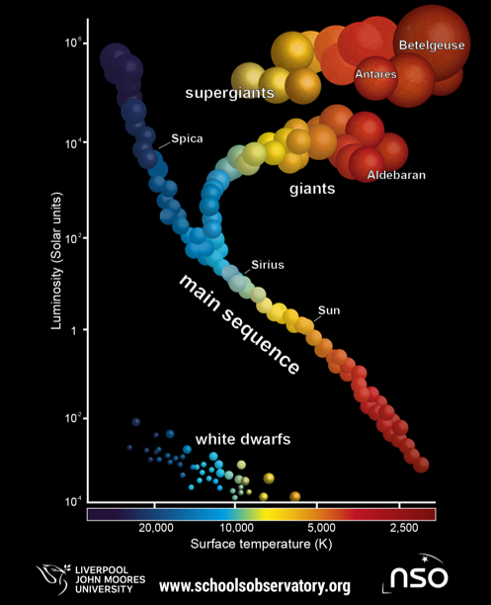
Project Idea & Scientific Motivation
Over 6,071 confirmed exoplanets discovered from ground- & space- based missions
Habitability criteria based on established astrophysical models
The goal of this project
Earth- or Super-Earth-sized rocky planets
Orbiting Sun-like (Type-G) Main Sequence stars
Located within the Habitable Zone (HZ) Inside the Galactic Habitable Zone (GHZ)
1 unsupervised learning model
2 supervised learning models
Based on key planetary and stellar features
Using data analysis and 3 machine learning models
Demonstrate application of computational modeling in Astronomy and Astrophysics.
Accelerate the discovery process of exoplanets.
Enhance understanding of exoplanet formation, classification, habitability.
3

Slide 4
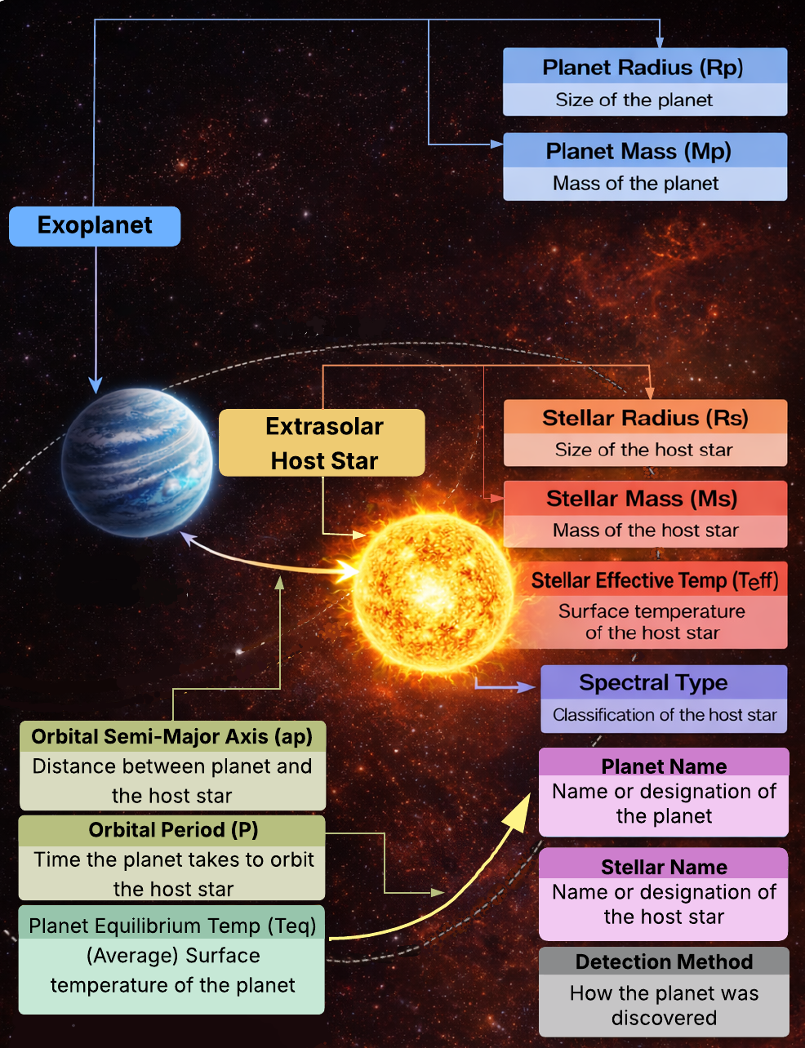
Dataset Background
Source: NASA exoplanet archive (open-source)
Contains 87 columns and 39,332 rows
Analytical challenges which require data cleaning and feature selection:
Duplicate rows for a single exoplanet
Redundant attributes
Missing data of important attributes
Typographical errors
Key planetary and stellar features:
Planet mass (In Earth mass)
Planet radius (In Earth radius)
Planet equilibrium temperature (In Kelvin)
Orbital period (In Earth Days)
Orbital semi-major axis (In Distance between Earth and Sun)
Stellar mass (In Sun mass)
Stellar radius (In Sun radius)
Stellar effective temperature (In Kelvin)
Spectral Type (Star Type + Luminosity)
4

Slide 5

Modeling Approach and Tools
Machine Learning
Unsupervised Learning: K-Means Clustering
Identifies natural groupings of exoplanets using planetary and stellar features
Partitions exoplanets into k clusters in standardized feature space
Minimizes Euclidean distance between similar exoplanets
Enables discovery of Earth-analog candidates without predefined habitability labels
Supervised Learning: Random Forest
Predicts exoplanet habitability likelihood
Robust to missing data, nonlinear relationships, and high-dimensional features
Uses an ensemble of decision trees trained on bootstrapped samples
Provides feature importance to interpret astrophysical significance
Supervised Learning: Gradient Boosted Decision Trees (GBDT)
Improves predictive accuracy of Random Forest
Sequentially builds trees to correct previous classification errors
Optimizes a loss function for habitability classification or scoring
Ranks Earth-like exoplanets based on habitability potential
Tools:
Programming Language: Python
Data Handling and Preprocessing: Pandas and NumPy
Machine Learning and Modeling: Scikit-learn and Tensorflow
Data Visualizations: Matplotlib.pyplot and Seaborn
Environment: Jupyter Notebook
5

Slide 6
Conclusion
Combines unsupervised and supervised models
Explore feature relationships
Addresses challenges in exoplanet characterization
Provides interpretable results through feature importance and clustering analysis
Highlights the value of computational modeling in Astronomy & Astrophysics analyses
Contributes to accelerating future exoplanet discovery and habitability assessment
Utilizes NASA’s Exoplanet Archive to analyze large-scale planetary and stellar data
Implementing three machine learning models
Applies a structured, scalable, and reproduceable data-driven framework
Classify exoplanets
Predict exoplanet habitability
Identifies Earth-like exoplanet candidates
Based on established astrophysical criteria and key features
6

Slide 7


Thank you! Questions?
7

